Slide 1




DU Capteur et Innovation technologique
Project Presentation
Topic :
Manufacturing a microscope (open flexure)
Presented by :
Tutors :
MUSHTAQ Aqib
MAIGA Yahiya Abdou
LOISON Pierre
CANNIZZO Caroline
2025 - 2026

Slide 2
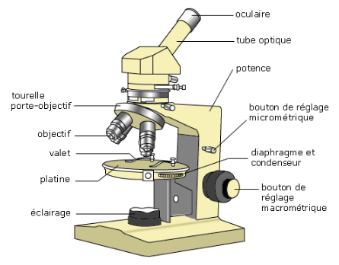
Context
Goal
Means & Needing
Deliverables
Risk
Planning
What is an optical microscope ?
is a scientific instrument
who uses visible light to enlarge objects of very small dimensions
Figure 1 : Description du microscope optique (®Prof Innovant)

Slide 3
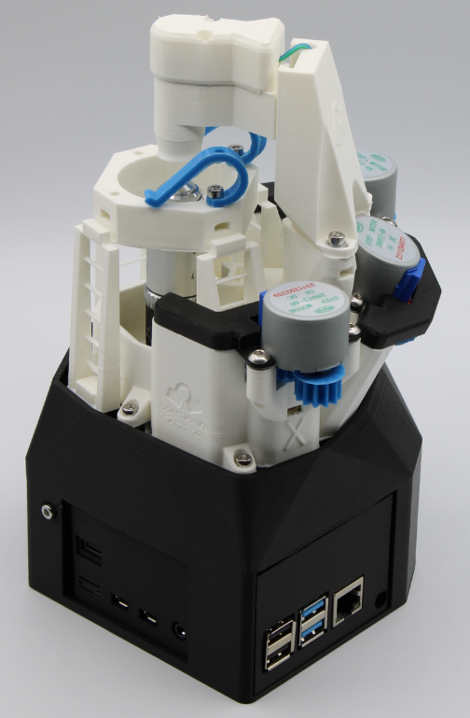
Context
Goal
Means & Needing
Deliverables
Risk
Planning
The open flexure microscope (Collins et al., 2019 ; Sharkey et al., 2016)
is an open-source and 3D printable microscope,
designed to democratize access to high-resolution scientific imaging through a modular, low-cost and customizable design.
high mechanical precision,
adaptability,
and its increasing adoption in educational, research, and medical diagnostic contexts
Figure 2 : Open flexure microscope (®OFM)

Slide 4


Context
Goal
Means & Needing
Deliverables
Risk
Planning
understand the operation of an optical sensor and the associated physical principles
design, assemble and calibrate an instrument from accessible and 3D-printable components;
test and validate the measurement performance (stability, precision, image quality);
concretely apply the concepts of sensors to a real instrument, in connection with experimental or environmental needs;
make an inexpensive, reliable and reproducible device.

Slide 5
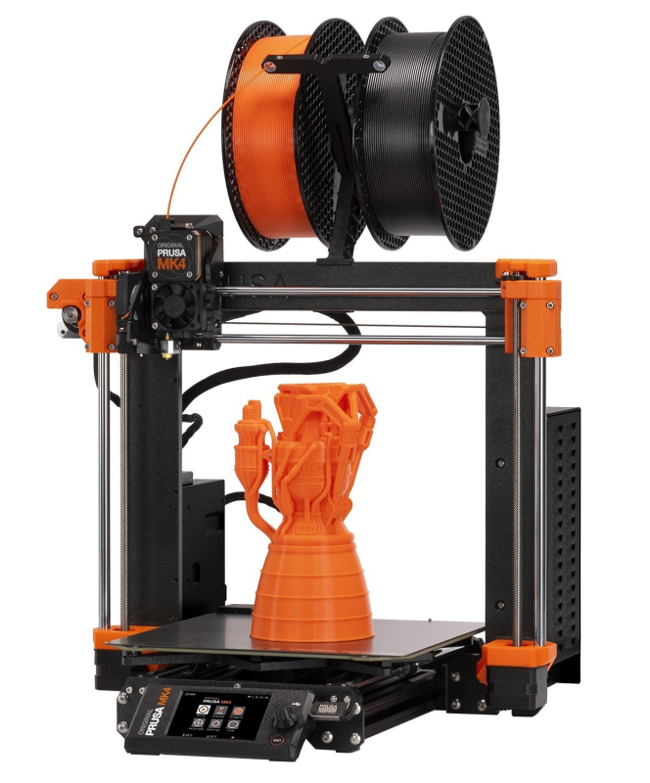
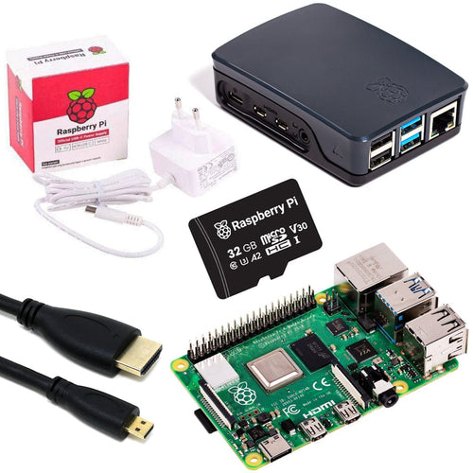
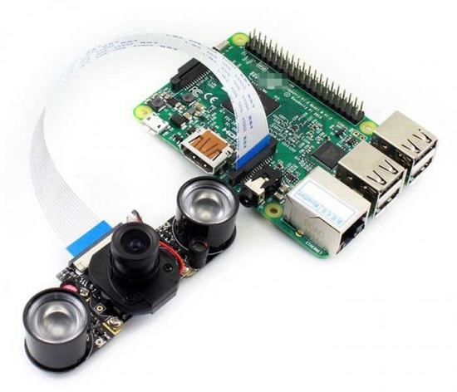
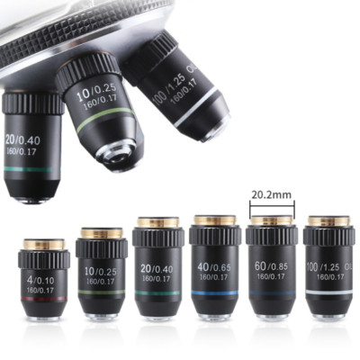
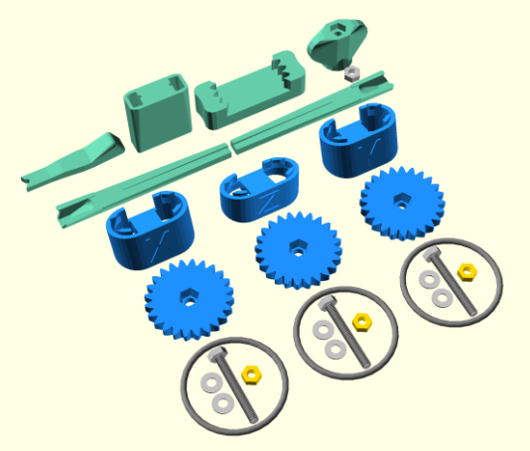
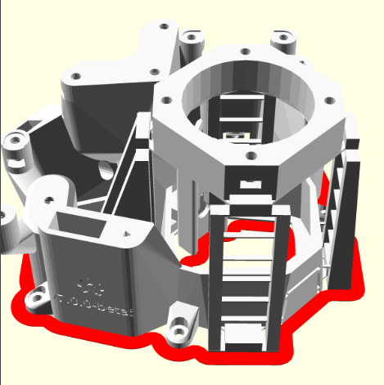
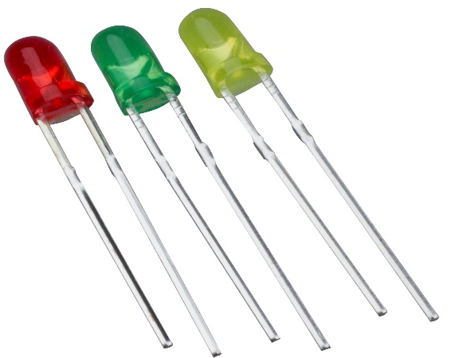
Context
Goal
Means & Needing
Deliverables
Risk
Planning
3D printer ;
RMS lenses, Raspberry Pi camera module, Micro SD card, micro-geared stepper motors ;
Microcontroller (ex : Raspberry Pi) ;
Stepper motors for precise movement in three axes ;
An LED illumination kit and various small mechanical components ;
A PC to control the microscope via Open Flexure software

Slide 6
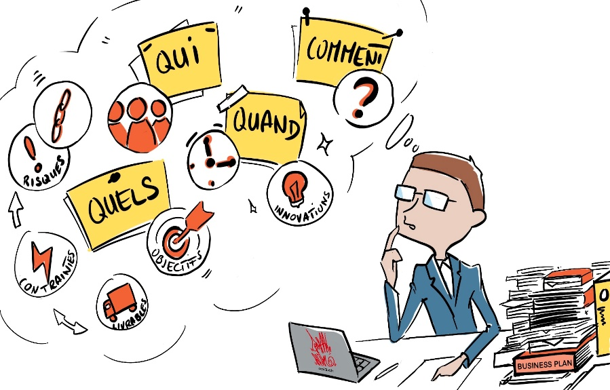


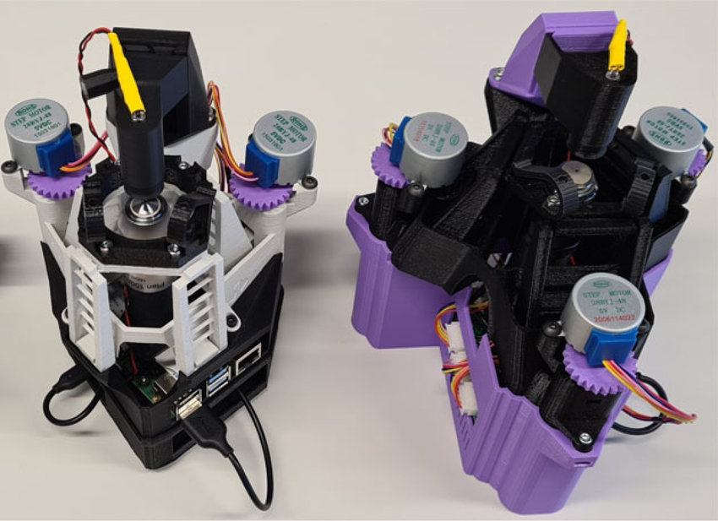
Context
Goal
Means & Needing
Deliverables
Risk
Planning
Design, scripts
Technical documentation on the steps of 3D printing, assembly and calibration.
Demonstration of use (e.g. image acquisition, calibration, maintenance, configuration of plugins).
Functional microscope (prototype)
Oral presentation

Slide 7
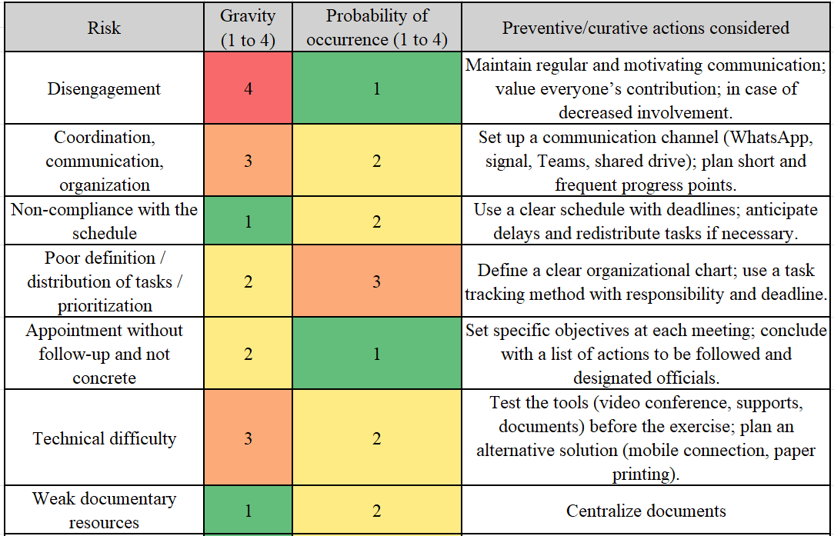
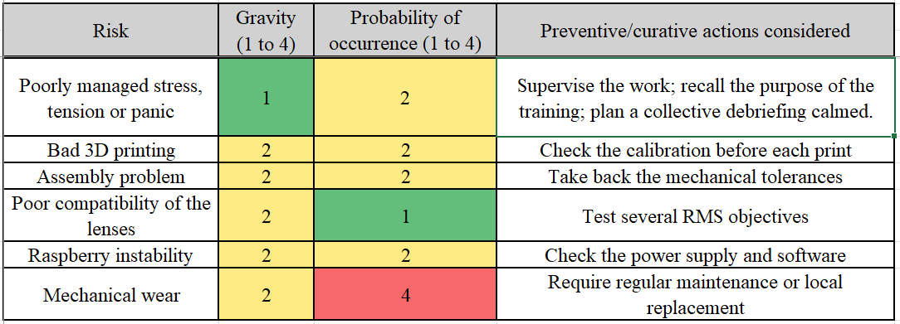
Context
Goal
Means & Needing
Deliverables
Risk
Planning
Gravité : 1-gênant, 2-très gênant, 3-grave, 4-fatal
Probabilité : 1-peu probable, 2-probable, 3-très probable, 4-quasi certain

Slide 8

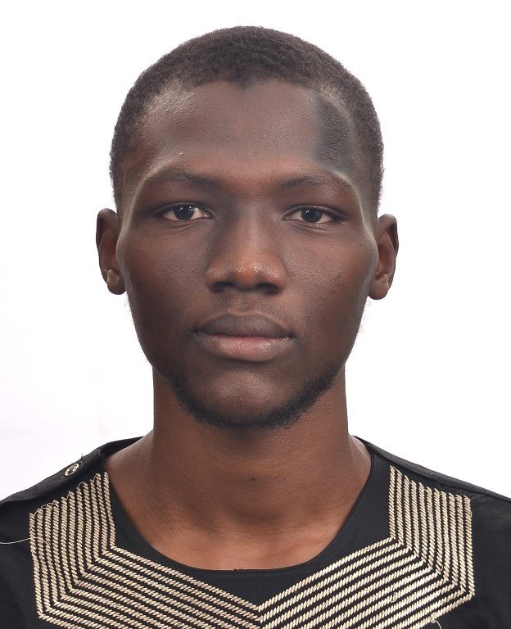
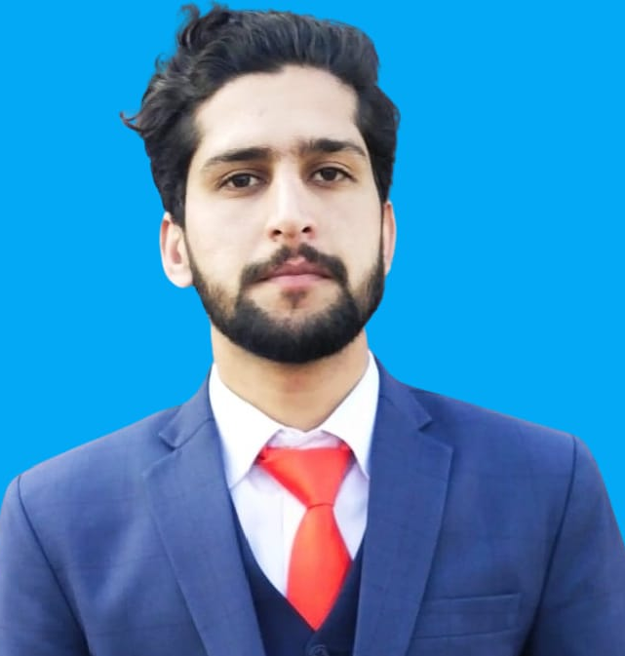
Team
MAIGA Yahiya Abdou​
MUSHTAQ Aqib
Hydrogeologist/ hydrologist, Synthesizing & modeling
Specialist of Internet Of Things
Motivation :
develop skills in electronics and instrumentation
design an instrument low cost, open source and reproducible
explore the application of the microscope to the rapid analysis of aqueous samples
Motivation :
experiment with connectivity and data transmission
develop a smart interface
linking IoT concepts to experimental science,
integrate sensors and electronic components

Slide 9
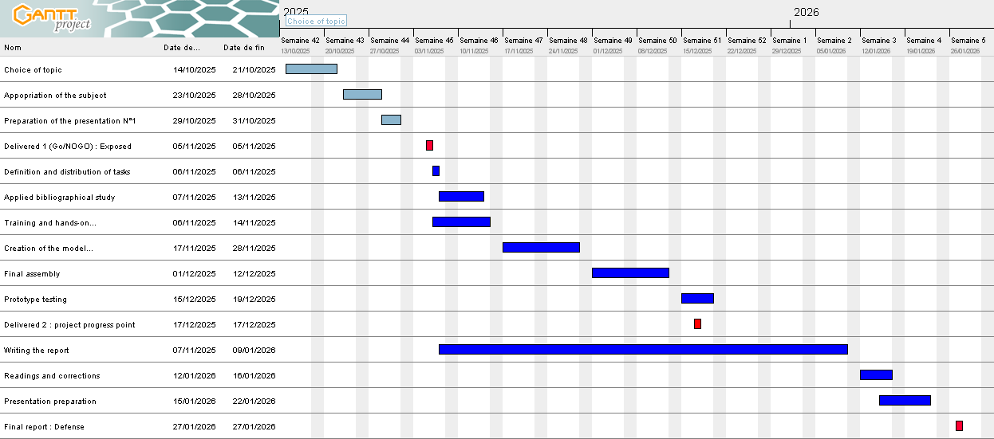
Context
Goal
Means & Needing
Deliverables
Risk
Planning

Slide 10

Organization of the project
Type of meeting | Frequency | Time | Lieu
Progress meetings | Once a week | 30 min | Fablab / Videoconferencing / Messaging
Teamwork meetings | 2 times a week | 8H to 12H | Fablab / Videoconferencing / Messaging
Meetings with the supervisor | once a week with the possibility of exchanging email and zoom | 1h | Fablab / Videoconferencing / Messaging

